Slide 1

Research Progress Update: Weeks 4 & 5

Slide 2
Overview
Denoising diffusion implicit models (DDIM)
Null Text Inversion
Online inference/recreate paper examples (Training with original code) Gradio
Progress on my paper
Next steps for my research
Methods for downstream tasks

Slide 3
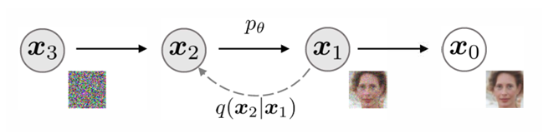
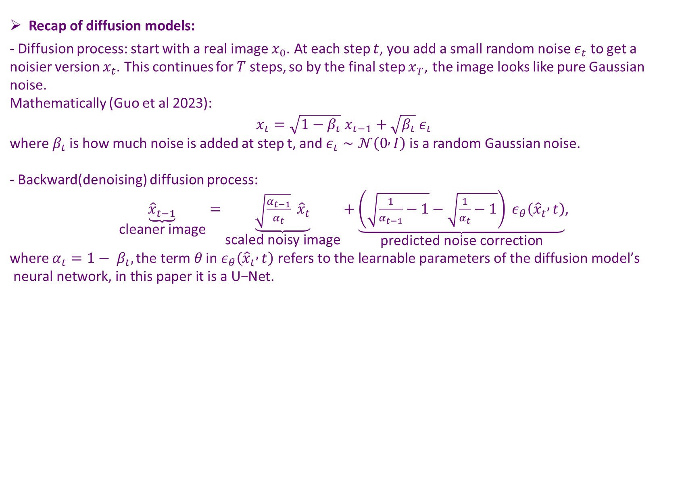
DDIM
Recap of diffusion models:
- Diffusion process: start with a real image $x_{0}$. At each step $t$, you add a small random noise $ε_{t}$ to get a noisier version $x_{t}$. This continues for $T$ steps, so by the final step $x_{T}$, the image looks like pure Gaussian noise.
Mathematically (Guo et al 2023):
$$x_{t}=\sqrt{1−β_{t}} x_{t−1}+\sqrt{β_{t}} ε_{t}$$
where$β_{t}$ is how much noise is added at step t, and $ε_{t}∼𝒩\left(0 , I\right)$is a random Gaussian noise.
- Backward(denoising) diffusion process:
$\underset{\text{cleaner} \text{image}}{\underbrace{{\hat{x}}_{t−1}}}=\underset{\text{scaled} \text{noisy} \text{image}}{\underbrace{\sqrt{\frac{α_{t−1}}{α_{t}}} {\hat{x}}_{t}}}+\underset{\text{predicted} \text{noise} \text{correction}}{\underbrace{\left(\sqrt{\frac{1}{α_{t−1}}−1}−\sqrt{\frac{1}{α_{t}}−1}\right) ε_{θ}\left({\hat{x}}_{t} , t\right)}}$,
where $α_{t}={1− β}_{t},\text{the} \text{term} θ \text{in} ε_{θ}\left({\hat{x}}_{t} , t\right) \text{refers} \text{to} \text{the} \text{learnable} \text{parameters} \text{of} \text{the} \text{diffusion} \text{model}\text{’}\text{s} \text{neural} \text{network}\text{, }\text{in} \text{this} \text{paper} \text{it} \text{is} \text{a} \text{U}\text{−}\text{Net}\text{.}$

Slide 4
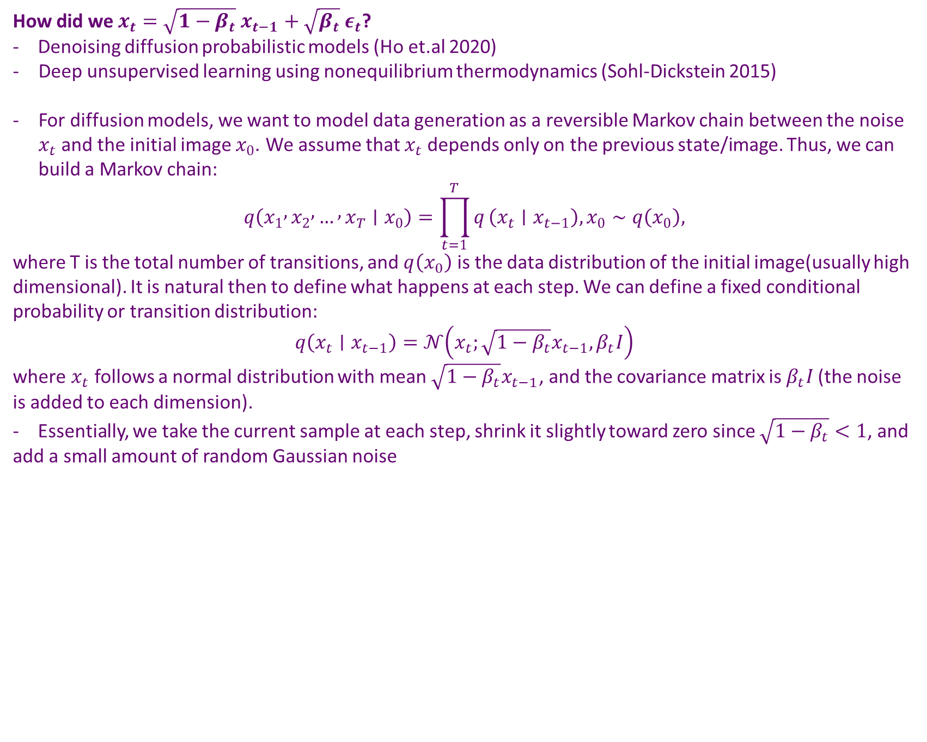
DDIM
How did we $x_{t}=\sqrt{1−β_{t}} x_{t−1}+\sqrt{β_{t}} ε_{t}$?
- Denoising diffusion probabilistic models (Ho et.al 2020)
Deep unsupervised learning using nonequilibrium thermodynamics (Sohl-Dickstein 2015)
For diffusion models, we want to model data generation as a reversible Markov chain between the noise $x_{t}$and the initial image $x_{0}$. We assume that $x_{t}$depends only on the previous state/image. Thus, we can build a Markov chain:
$$q\left(x_{1} , x_{2} , … , x_{T}∣x_{0}\right)=\prod_{t=1}^{T}{q}\left(x_{t}∣x_{t−1}\right), x_{0}∼q\left(x_{0}\right),$$
where T is the total number of transitions, and $q\left(x_{0}\right)$ is the data distribution of the initial image(usually high dimensional). It is natural then to define what happens at each step. We can define a fixed conditional probability or transition distribution:
$$q\left(x_{t}∣x_{t−1}\right)=𝒩\left(x_{t};\sqrt{1−β_{t}}x_{t−1},β_{t}I\right)$$
where $x_{t}$ follows a normal distribution with mean $\sqrt{1−β_{t}}x_{t−1}$, and the covariance matrix is $β_{t}I$(the noise is added to each dimension).
- Essentially, we take the current sample at each step, shrink it slightly toward zero since $\sqrt{1−β_{t}}<1$, and add a small amount of random Gaussian noise

Slide 5
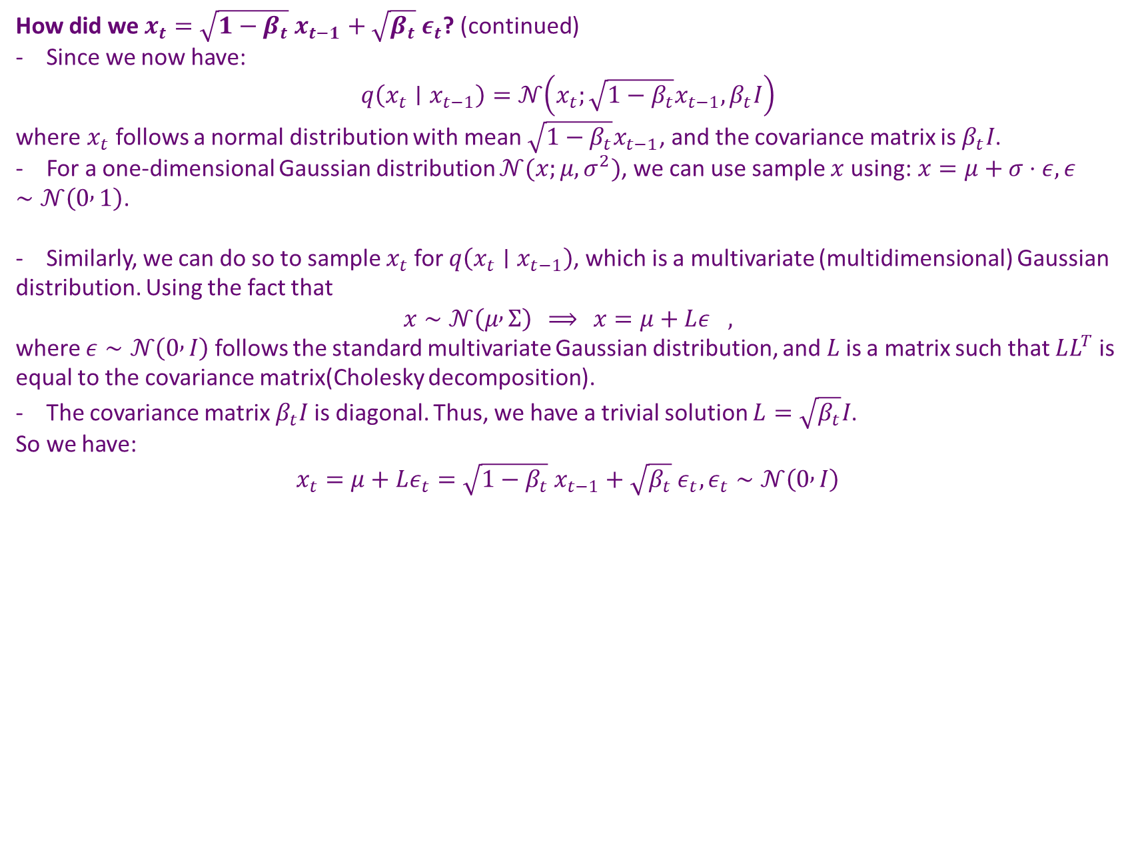
DDIM
How did we $x_{t}=\sqrt{1−β_{t}} x_{t−1}+\sqrt{β_{t}} ε_{t}$? (continued)
- Since we now have:
$$q\left(x_{t}∣x_{t−1}\right)=𝒩\left(x_{t};\sqrt{1−β_{t}}x_{t−1},β_{t}I\right)$$
where $x_{t}$ follows a normal distribution with mean $\sqrt{1−β_{t}}x_{t−1}$, and the covariance matrix is $β_{t}I$.
- For a one-dimensional Gaussian distribution $𝒩(x;μ,σ^{2})$, we can use sample $x$using:$x=μ+σ⋅ε, ε∼𝒩\left(0 , 1\right)$.
- Similarly, we can do so to sample $x_{t}$for $q\left(x_{t}∣x_{t−1}\right)$, which is a multivariate (multidimensional) Gaussian distribution. Using the fact that
$$x∼𝒩\left(μ , Σ\right) ⟹ x=μ+Lε_{},$$
where $ε∼𝒩\left(0 , I\right)$ follows the standard multivariate Gaussian distribution, and$L$is a matrix such that $LL^{T}$is equal to the covariance matrix(Cholesky decomposition).
- The covariance matrix $β_{t}I$is diagonal. Thus, we have a trivial solution $L=\sqrt{β_{t}}I$.
So we have:
$$x_{t}=μ+Lε_{t}=\sqrt{1−β_{t}} x_{t−1}+\sqrt{β_{t}} ε_{t},ε_{t}∼𝒩\left(0 , I\right)$$

Slide 6
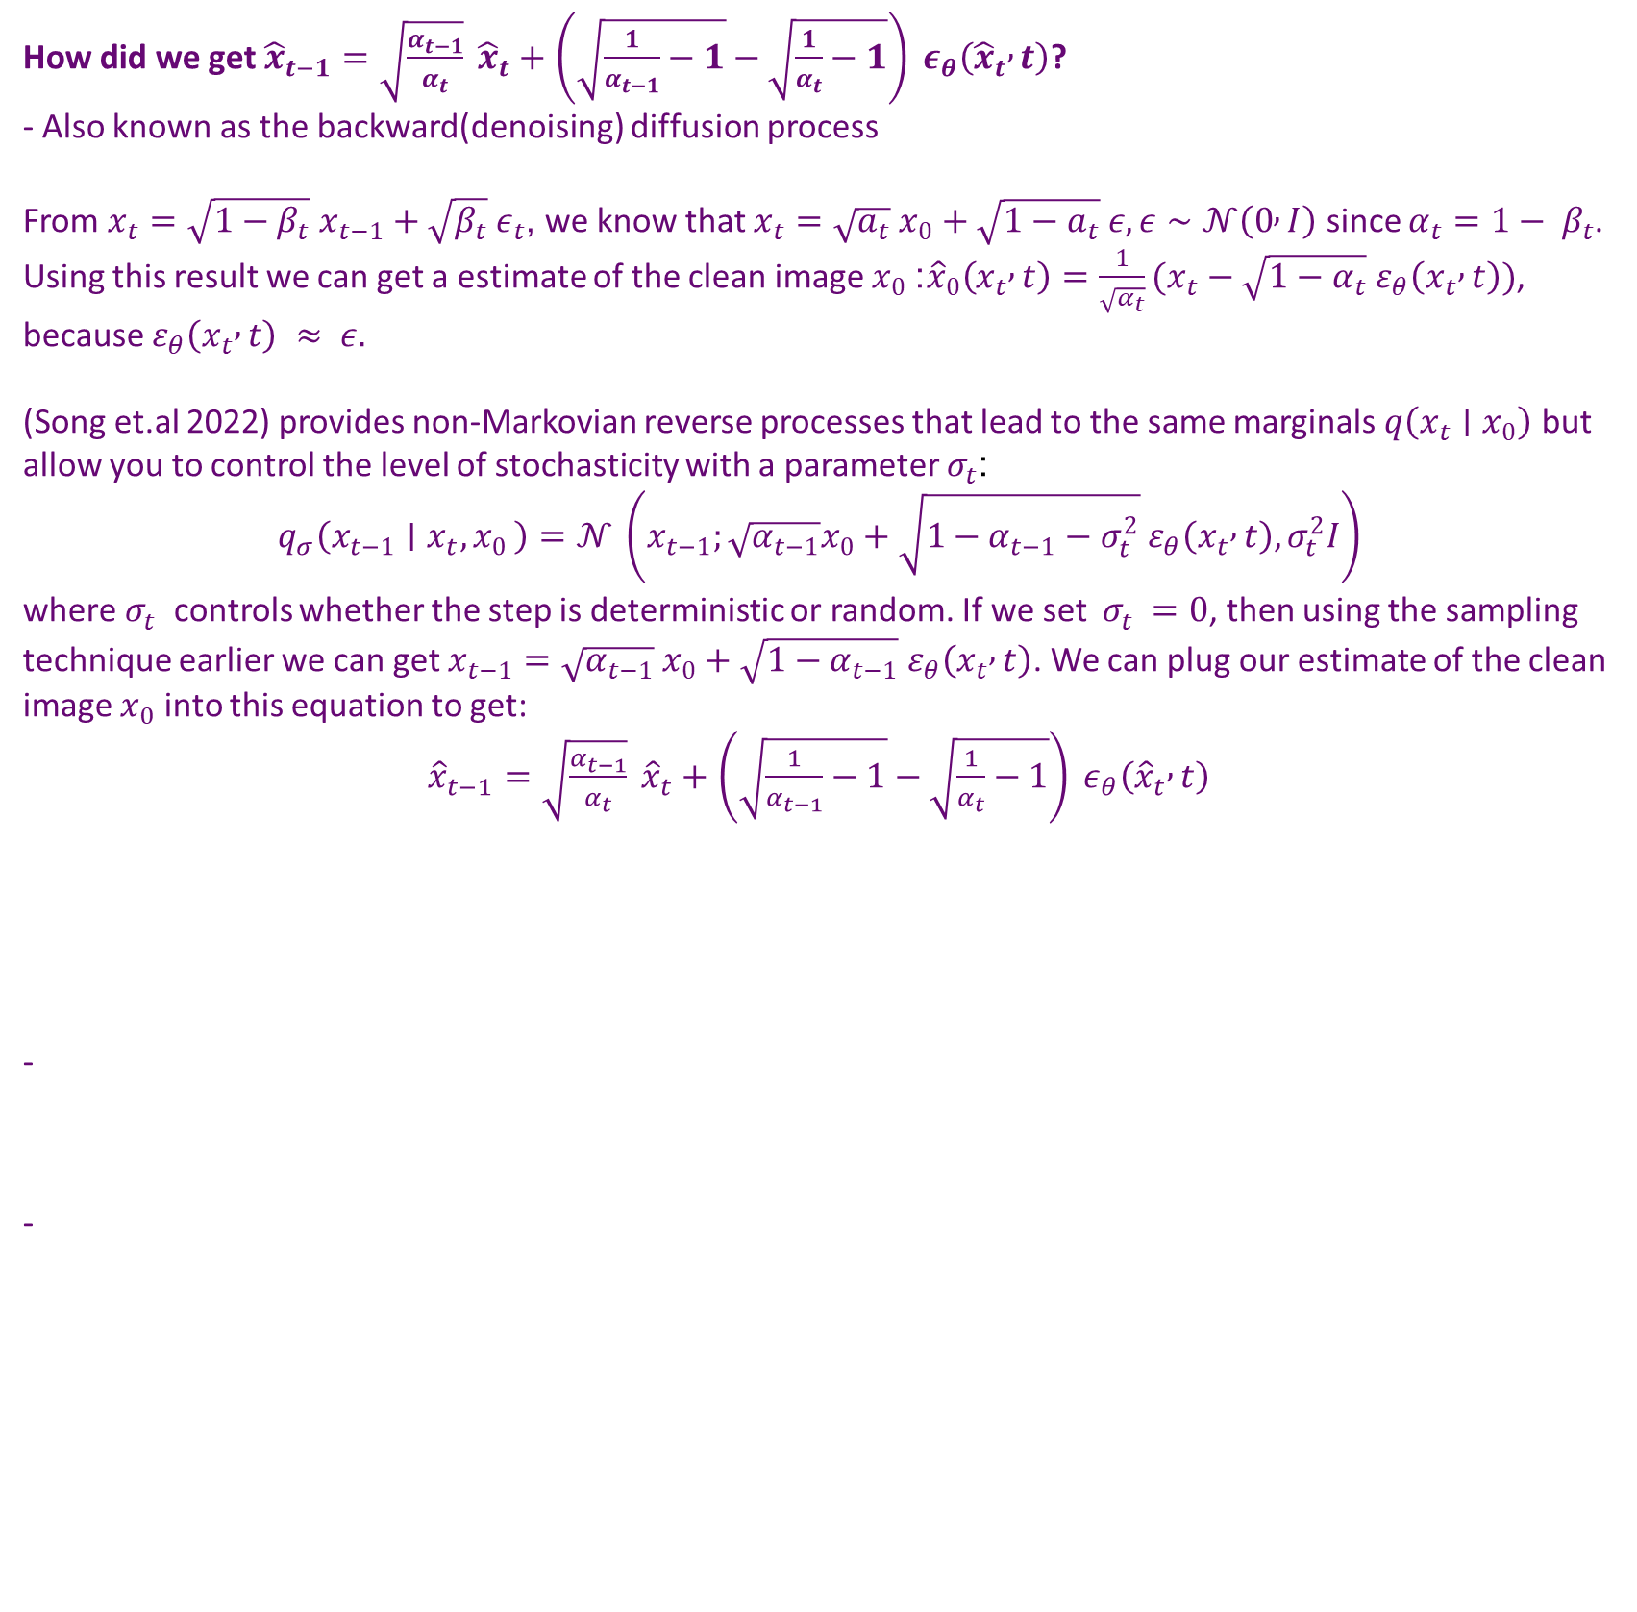
DDIM
How did we get${\hat{x}}_{t−1}=\sqrt{\frac{α_{t−1}}{α_{t}}} {\hat{x}}_{t}+$ $\left(\sqrt{\frac{1}{α_{t−1}}−1}−\sqrt{\frac{1}{α_{t}}−1}\right) ε_{θ}\left({\hat{x}}_{t} , t\right)$?
- Also known as the backward(denoising) diffusion process
From $x_{t}=\sqrt{1−β_{t}} x_{t−1}+\sqrt{β_{t}} ε_{t}$, we know that $x_{t}=\sqrt{a_{t}} x_{0}+\sqrt{1−a_{t}} ε, ε∼𝒩\left(0 , I\right)$ since $α_{t}={1− β}_{t}$. Using this result we can get a estimate of the clean image $x_{0}$: ${\hat{x}}_{0}\left(x_{t} , t\right)=\frac{1}{\sqrt{α_{t}}}(x_{t}−\sqrt{1−α_{t}} ε_{θ}\left(x_{t} , t\right))$, because $ε_{θ}\left(x_{t} , t\right) ≈ ε.$
(Song et.al 2022) provides non-Markovian reverse processes that lead to the same marginals $q\left(x_{t}∣x_{0}\right)$ but allow you to control the level of stochasticity with a parameter $σ_{t}$:
$$q_{σ}\left(x_{t−1}∣x_{t}{,x}_{0}\right)=𝒩 \left(x_{t−1};\sqrt{α_{t−1}}x_{0}+\sqrt{1−α_{t−1}−σ_{t}^{2}} ε_{θ}\left(x_{t} , t\right),σ_{t}^{2}I\right)$$
where${ σ}_{t}^{}$controls whether the step is deterministic or random. If we set ${ σ}_{t}^{}=0$, then using the sampling technique earlier we can get $x_{t−1}=\sqrt{α_{t−1}} x_{0}+\sqrt{1−α_{t−1}} ε_{θ}\left(x_{t} , t\right)$. We can plug our estimate of the clean image $x_{0}$ into this equation to get:
${\hat{x}}_{t−1}=\sqrt{\frac{α_{t−1}}{α_{t}}} {\hat{x}}_{t}+$ $\left(\sqrt{\frac{1}{α_{t−1}}−1}−\sqrt{\frac{1}{α_{t}}−1}\right) ε_{θ}\left({\hat{x}}_{t} , t\right)$
-

Slide 7
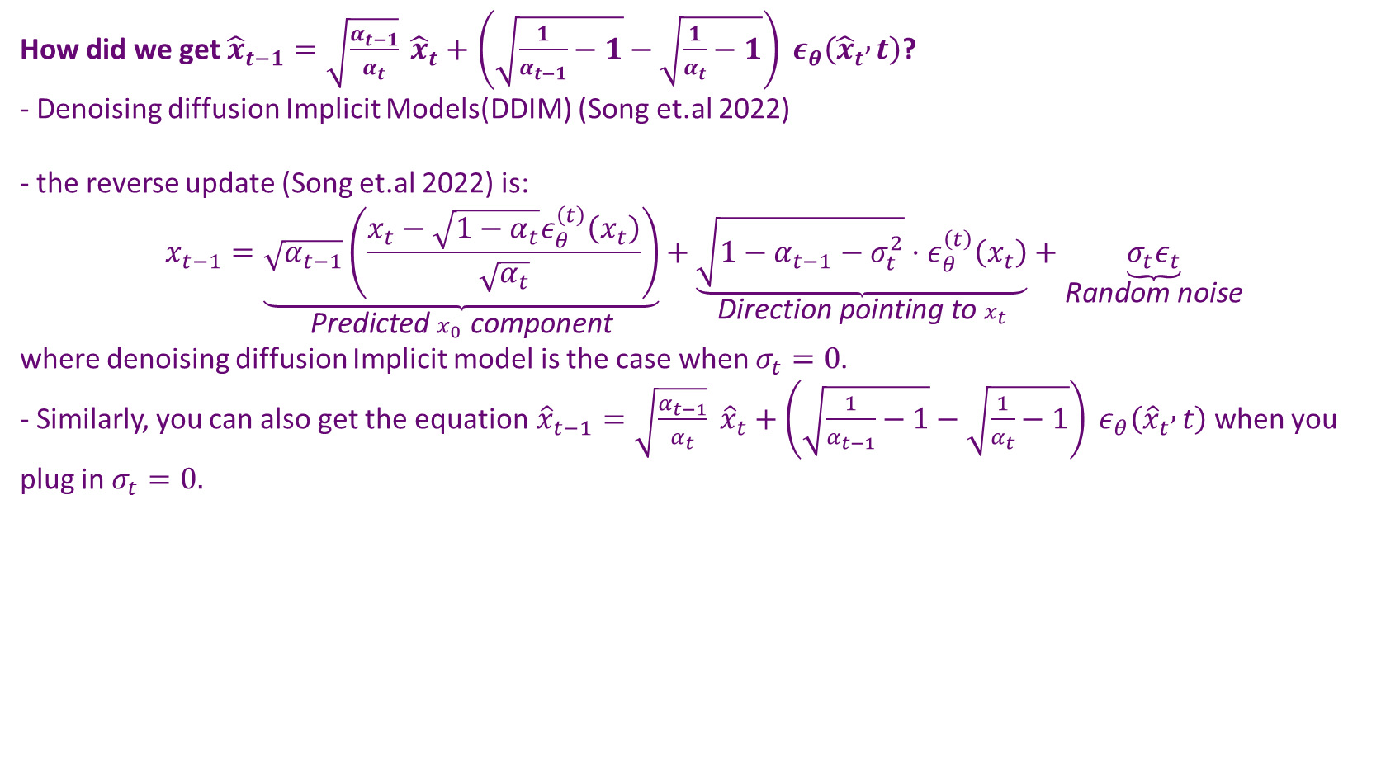
DDIM
How did we get${\hat{x}}_{t−1}=\sqrt{\frac{α_{t−1}}{α_{t}}} {\hat{x}}_{t}+$ $\left(\sqrt{\frac{1}{α_{t−1}}−1}−\sqrt{\frac{1}{α_{t}}−1}\right) ε_{θ}\left({\hat{x}}_{t} , t\right)$?
- Denoising diffusion Implicit Models(DDIM) (Song et.al 2022)
- the reverse update (Song et.al 2022) is:
$$x_{t−1}=\underset{\text{Predicted} x_{0} \text{component}}{\underbrace{\sqrt{α_{t−1}}\left(\frac{x_{t}−\sqrt{1−α_{t}}ε_{θ}^{\left(t\right)}\left(x_{t}\right)}{\sqrt{α_{t}}}\right)}}+\underset{\text{Direction} \text{pointing} \text{to} x_{t}}{\underbrace{\sqrt{1−α_{t−1}−σ_{t}^{2}}⋅ε_{θ}^{\left(t\right)}\left(x_{t}\right)}}+\underset{\text{Random} \text{noise}}{\underbrace{σ_{t}ε_{t}}}$$
where denoising diffusion Implicit model is the case when $σ_{t}=0$.
- Similarly, you can also get the equation${\hat{x}}_{t−1}=\sqrt{\frac{α_{t−1}}{α_{t}}} {\hat{x}}_{t}+$ $\left(\sqrt{\frac{1}{α_{t−1}}−1}−\sqrt{\frac{1}{α_{t}}−1}\right) ε_{θ}\left({\hat{x}}_{t} , t\right)$when you plug in $σ_{t}=0.$

Slide 8
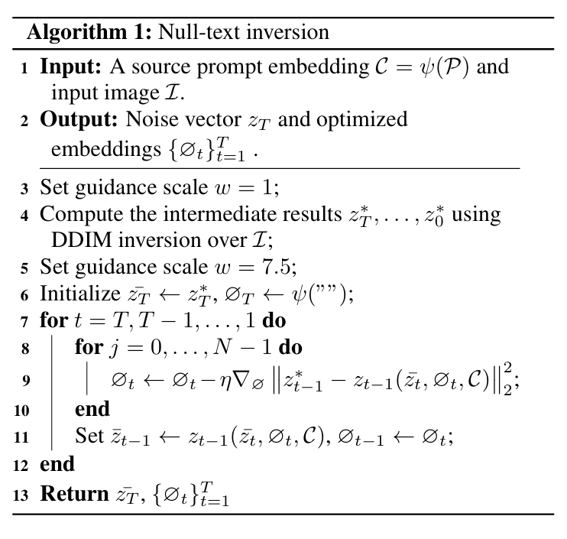

Null Text Inversion
-
Null Text Inversion:
- We first input $C=ψ\left(P\right)$, the text embedding of the source prompt $P$, where $ψ$is the text encoder, $I$ is the real image we want to reconstruct.
- We want to output $z_{T}$(or${ x}_{T}$), the optimized initial latent noise vector that, when used with the source prompt $P$ and optimized null-texts, perfectly reconstructs the initial image. We also want to output ${\{∅}_{t}{\left.\}\right.}_{t=1}^{T}$, which is the optimized null-text embeddings for each timestep $t$. Each embedding compensates for classifier guidance-induced distortion at its timestep.
Null-text Inversion for Editing Real Images using Guided Diffusion Models(Mokady et.al 2023)

Slide 9
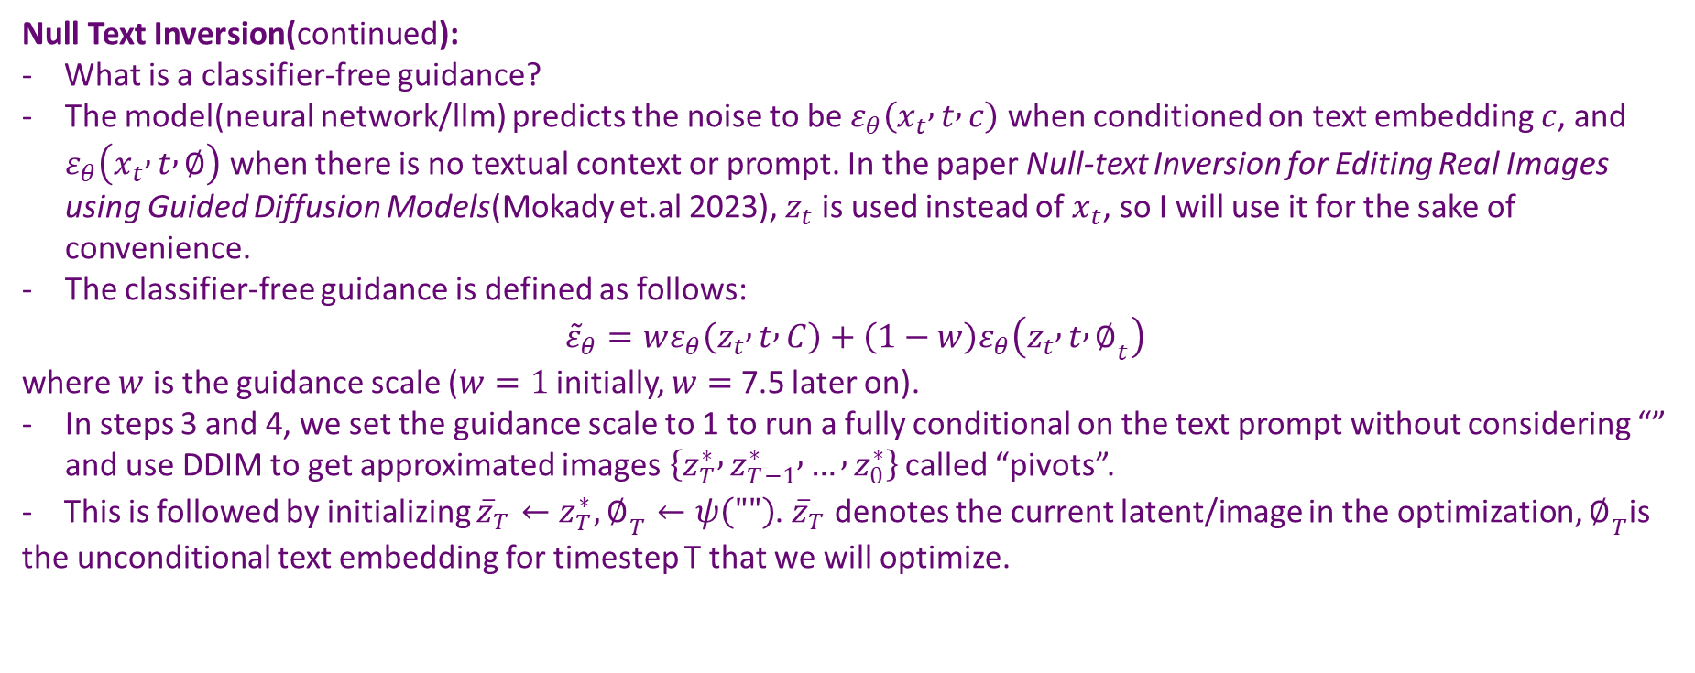
Null Text Inversion
Null Text Inversion(continued):
- What is a classifier-free guidance?
The model(neural network/llm) predicts the noise to be $ε_{θ}\left(x_{t} , t , c\right)$ when conditioned on text embedding $c$, and $ε_{θ}\left(x_{t} , t , ∅\right)$ when there is no textual context or prompt. In the paper Null-text Inversion for Editing Real Images using Guided Diffusion Models(Mokady et.al 2023), $z_{t}$is used instead of $x_{t}$, so I will use it for the sake of convenience.
The classifier-free guidance is defined as follows:
$${\tilde{ε}}_{θ}=wε_{θ}\left(z_{t} , t , C\right)+\left(1−w\right)ε_{θ}\left(z_{t} , t , ∅_{t}\right)$$
where $w$ is the guidance scale ($w=1$ initially, $w=$ 7.5 later on).
In steps 3 and 4, we set the guidance scale to 1 to run a fully conditional on the text prompt without considering “” and use DDIM to get approximated images$\left\{z_{T}^{∗} , z_{T−1}^{∗} , … , z_{0}^{∗}\right\}$ called “pivots”.
- This is followed by initializing ${\overline{z}}_{T}←z_{T}^{∗}, ∅_{T}←ψ\left(""\right)$. ${\overline{z}}_{T}$ denotes the current latent/image in the optimization, $∅_{T}$is the unconditional text embedding for timestep T that we will optimize.

Slide 10
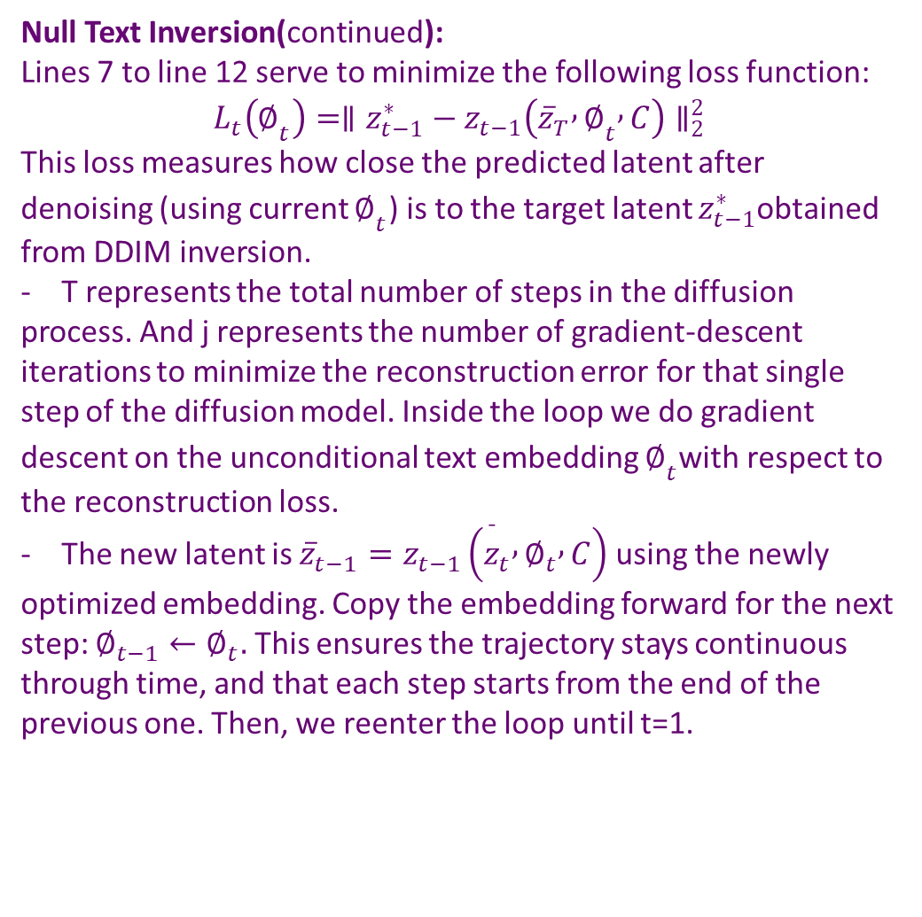
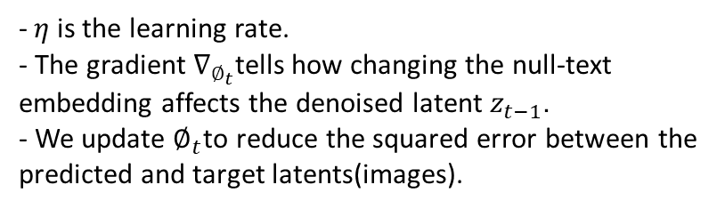
Null Text Inversion
-$η$is the learning rate.
- The gradient $∇_{∅_{t}}$tells how changing the null-text embedding affects the denoised latent $z_{t−1}$.
- We update $∅_{t}$to reduce the squared error between the predicted and target latents(images).
Null Text Inversion(continued):
Lines 7 to line 12 serve to minimize the following loss function:
$$L_{t}\left(∅_{t}\right)=∥z_{t−1}^{∗}−z_{t−1}\left({\overline{z}}_{T} , ∅_{t} , C\right)∥_{2}^{2}$$
This loss measures how close the predicted latent after denoising (using current $∅_{t}$) is to the target latent $z_{t−1}^{∗}$obtained from DDIM inversion.
- T represents the total number of steps in the diffusion process. And j represents the number of gradient-descent iterations to minimize the reconstruction error for that single step of the diffusion model. Inside the loop we do gradient descent on the unconditional text embedding $∅_{t}$with respect to the reconstruction loss.
- The new latent is ${\overline{z}}_{t−1}=z_{t−1}\left({\overset{ˉ}{z}}_{t} , ∅_{t} , C\right)$ using the newly optimized embedding. Copy the embedding forward for the next step: $∅_{t−1}←∅_{t}.$ This ensures the trajectory stays continuous through time, and that each step starts from the end of the previous one. Then, we reenter the loop until t=1.

Slide 11
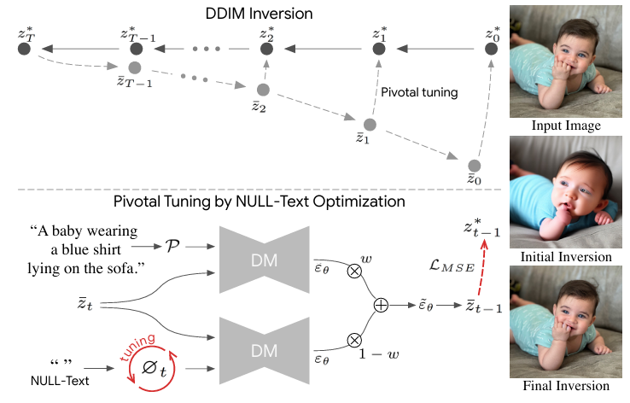
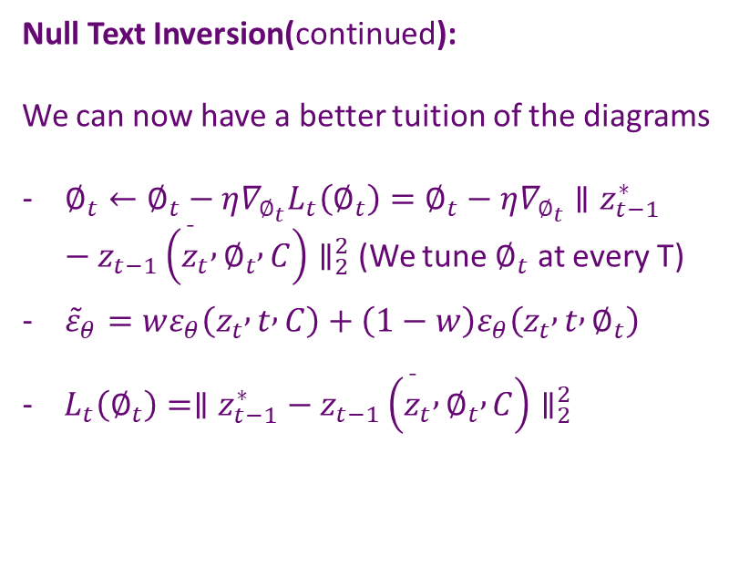

Null Text Inversion
Null Text Inversion(continued):
We can now have a better tuition of the diagrams
$∅_{t}←∅_{t}−η∇_{∅_{t}}L_{t}\left(∅_{t}\right)=∅_{t}−η∇_{∅_{t}}∥z_{t−1}^{∗}−z_{t−1}\left({\overset{ˉ}{z}}_{t} , ∅_{t} , C\right)∥_{2}^{2}$ (We tune $∅_{t}$ at every T)
${\tilde{ε}}_{θ}=wε_{θ}\left(z_{t} , t , C\right)+\left(1−w\right)ε_{θ}\left(z_{t} , t , ∅_{t}\right)$
- $L_{t}\left(∅_{t}\right)=∥z_{t−1}^{∗}−z_{t−1}\left({\overset{ˉ}{z}}_{t} , ∅_{t} , C\right)∥_{2}^{2}$
$$C=ψ\left(P\right)$$

Slide 12
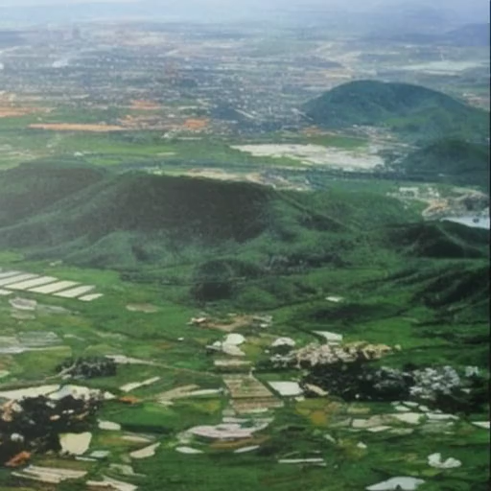
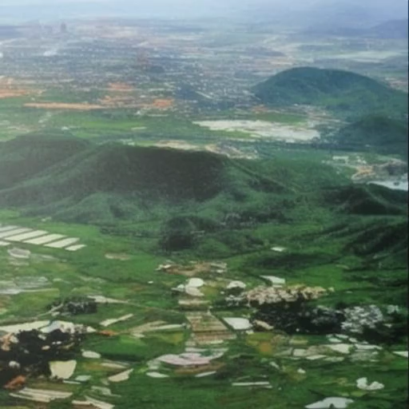
Online inference
Gradio
Untitled2.ipynb - Colab
Experiment Setup (implementation)
The smooth diffusion is trained atop pretrained Stable Diffusion V-1.5, using LoRA
LAION Aesthetics 6.5+ as the training dataset
Video Results with smooth diffusion:
Null Text Inversion:
Denoising diffusion implicit models(DDIM):
17 frames, 8 frames per second
17 frames, 8 frames per second

Slide 13
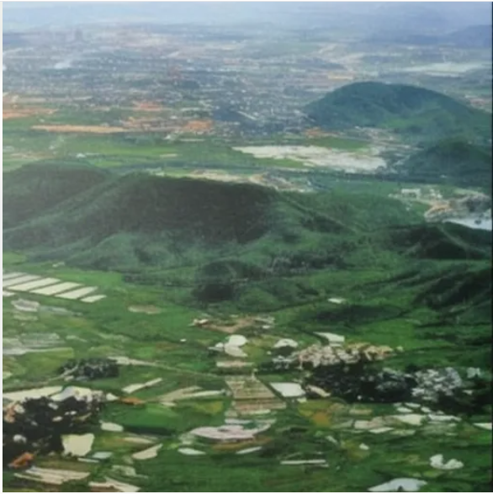
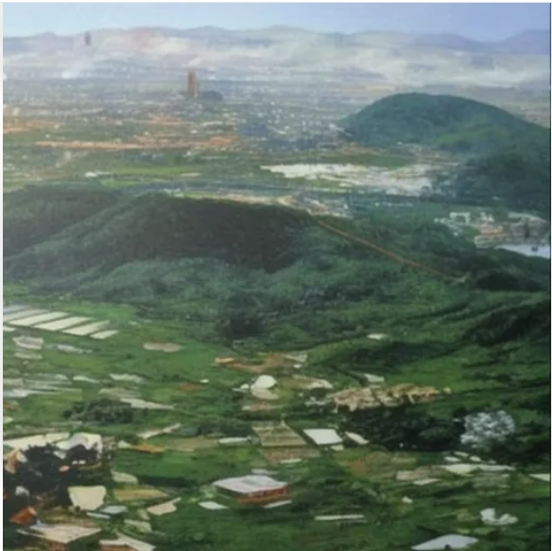
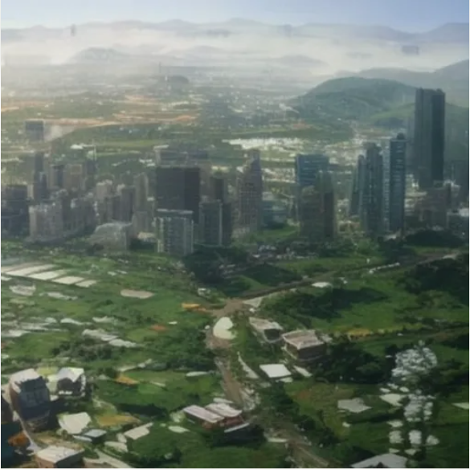
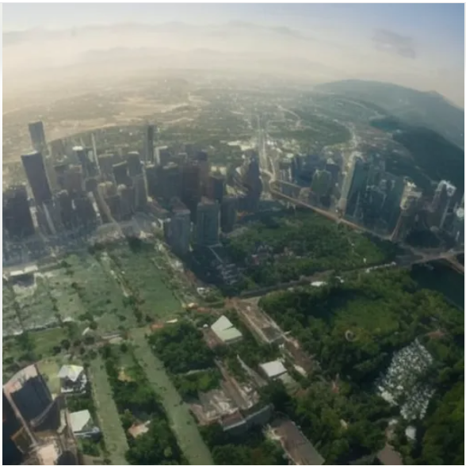
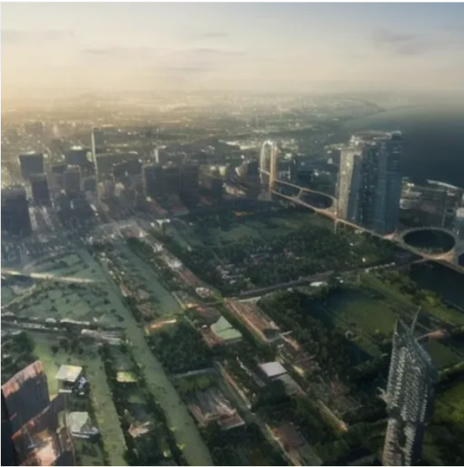
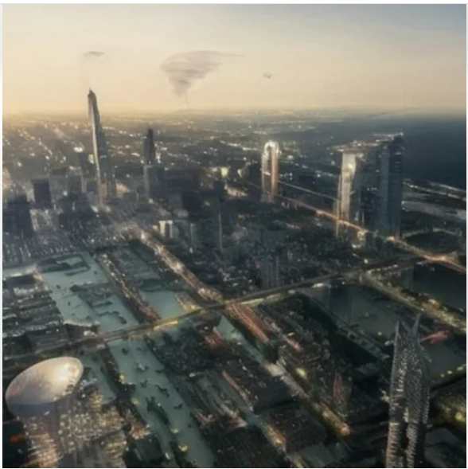
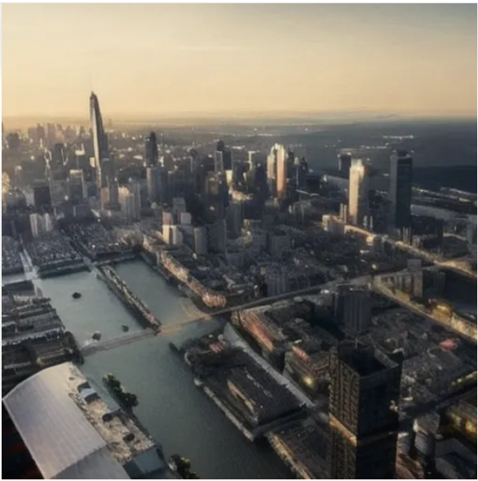
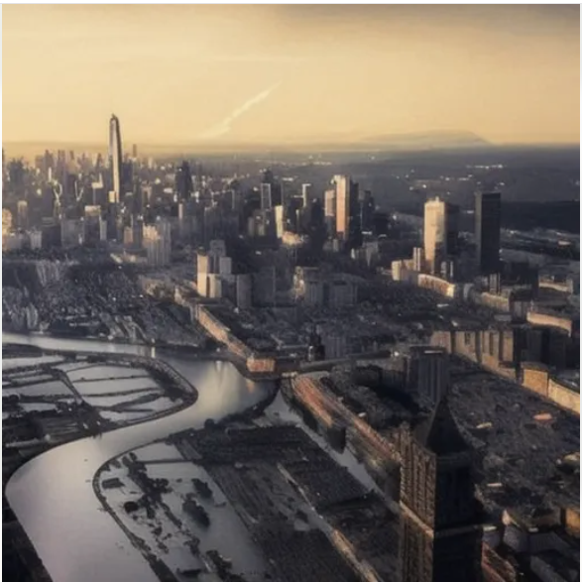
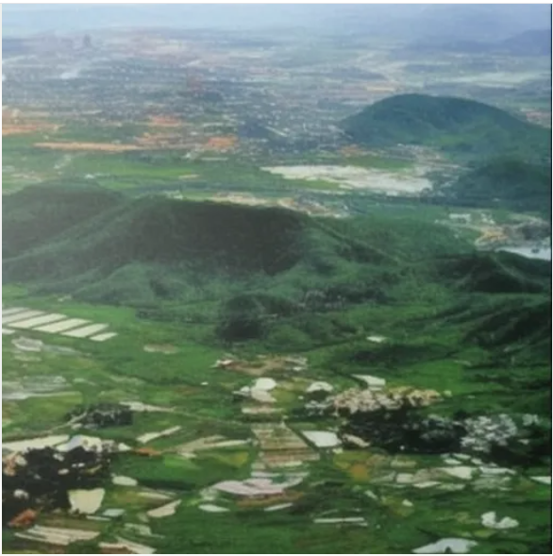
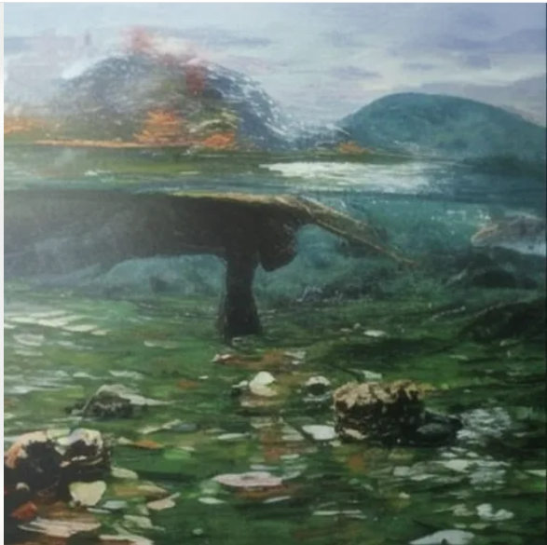
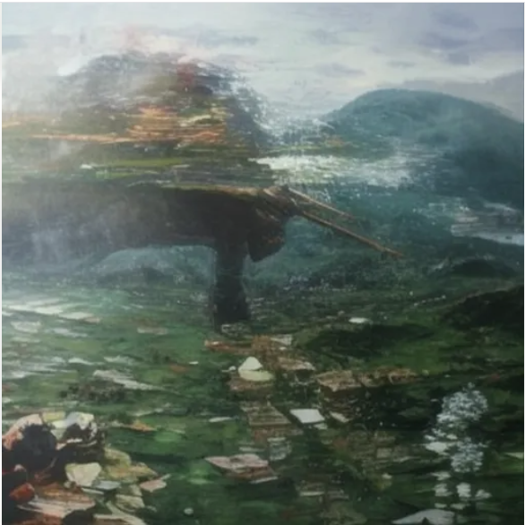
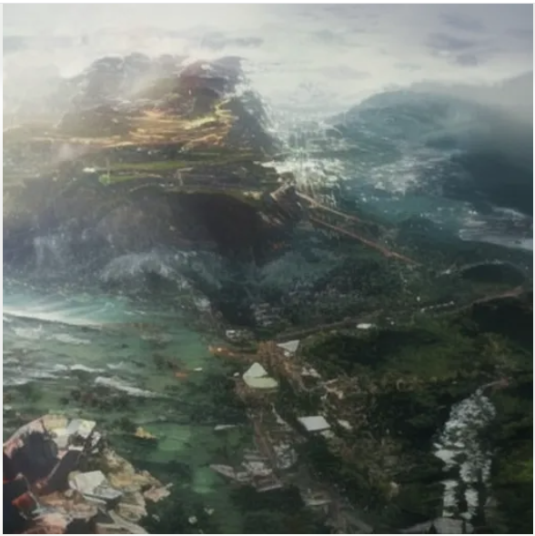
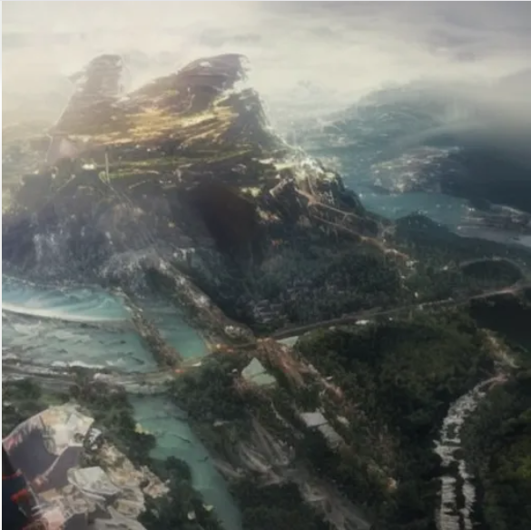
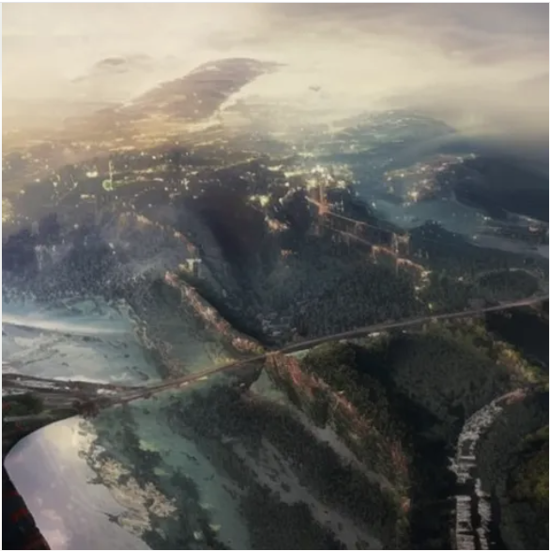
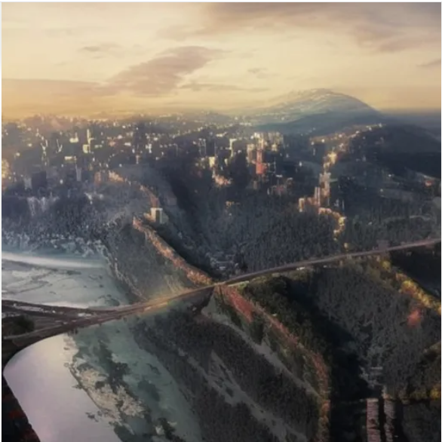
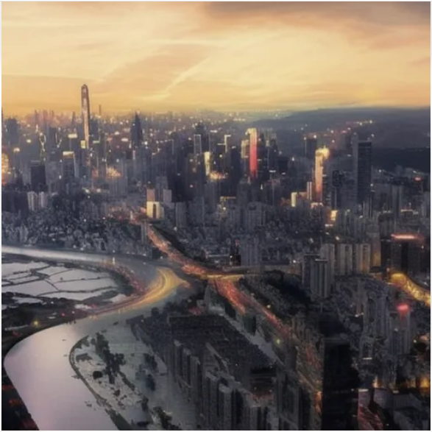
Online inference
Frame Results with smooth diffusion (Comparison):
Null Text Inversion:
Denoising diffusion implicit models(DDIM):

Slide 14
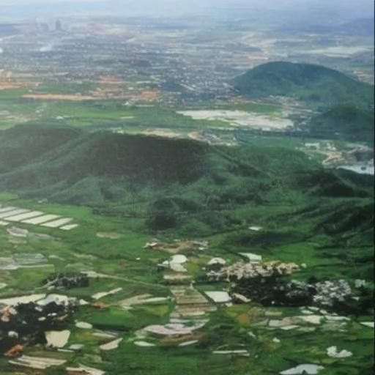
Online inference
Gradio
Untitled2.ipynb - Colab
Video Results with and without smooth diffusion for Null Text Inversion (NTI):
Null Text Inversion with smooth diffusion:
Null Text Inversion without smooth diffusion:
17 frames, 8 frames per second
17 frames, 8 frames per second
Confirmed that smooth diffusion actually works.

Slide 15
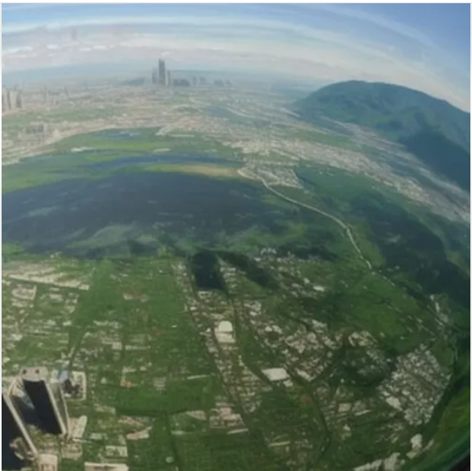
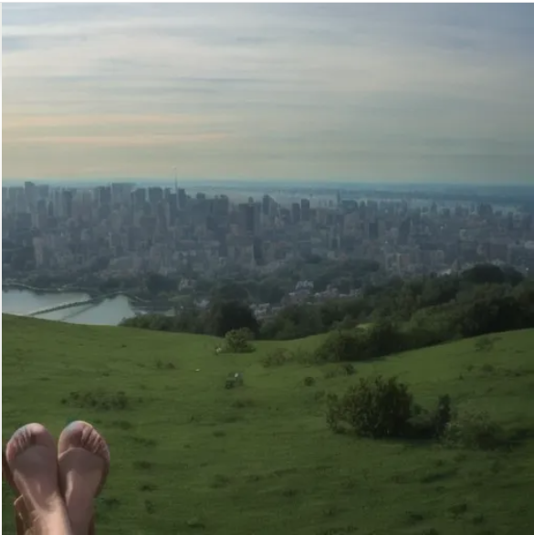
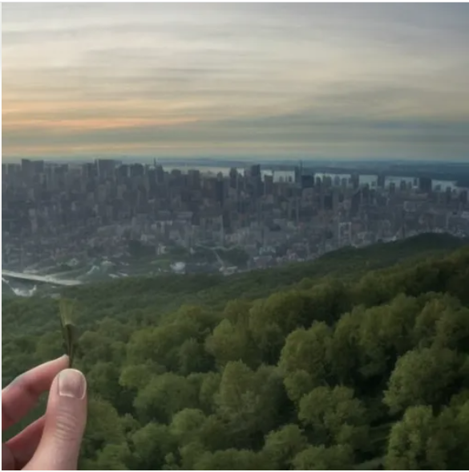
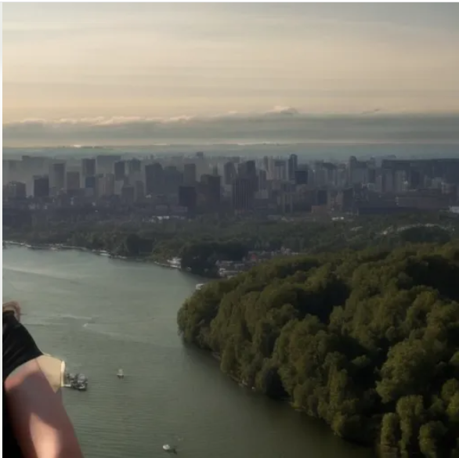
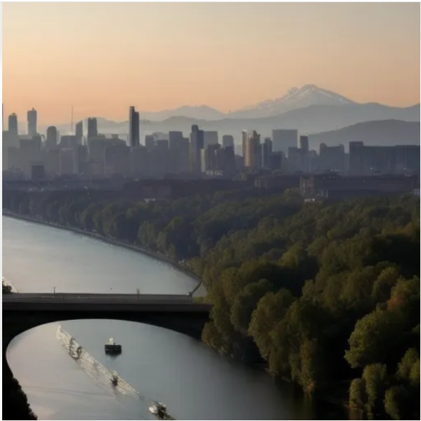
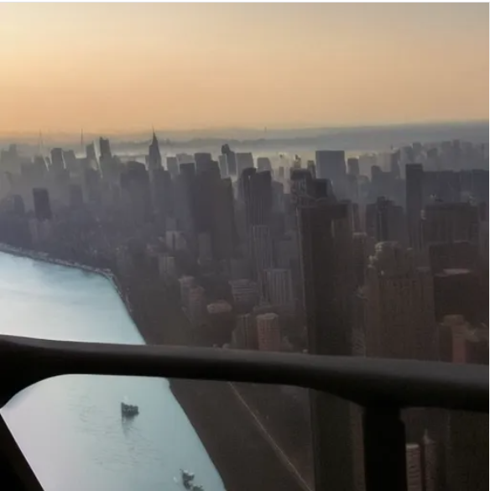
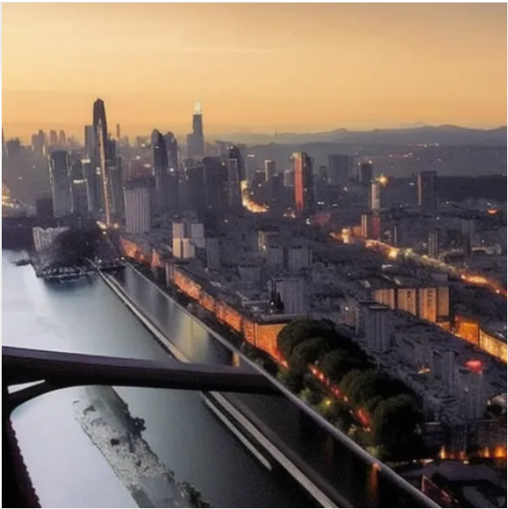
Online inference
Frame Results with and without smooth diffusion (Comparison):
Null Text Inversion with smooth diffusion:
Null Text Inversion with stable diffusion:

Slide 16
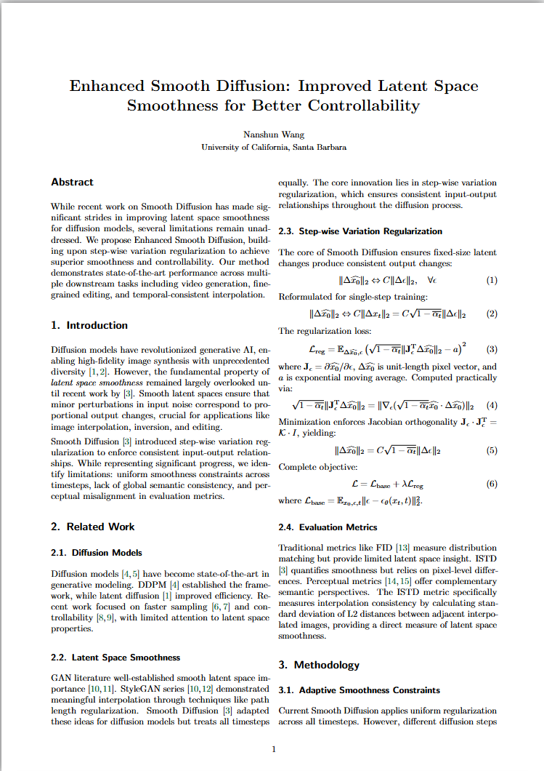
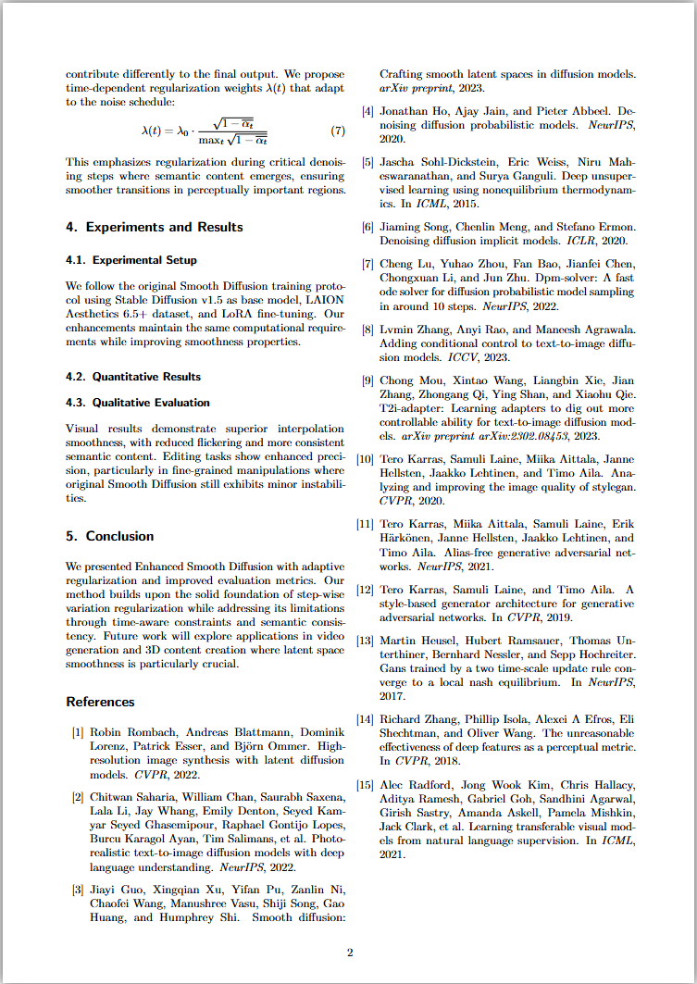
Paper
Independent Studies paper - Online LaTeX Editor Overleaf
I have outlined the entire paper from abstract, introduction, related works, experiments and results.
Cited 15 previous works that I referenced
included the step wise variation regularization method
Yet to reflect the results I got for implementing image interpolation with DDIM

Slide 17
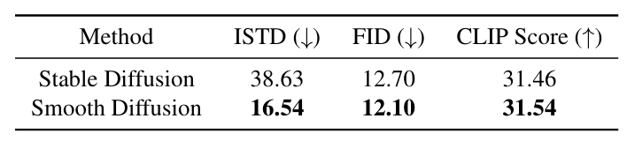
Next Steps
What I have accomplished:
Running the original smooth diffusion model and validating it with an example (countryside to city)
Using the denoising diffusion implicit model to run stable diffusion and smooth diffusion (NTI used in paper)
Next steps:
Continue finding new methods for downstream tasks (other than using DDIM for interpolation)
Improve on the smooth diffusion and interpolation standard deviation(ISTD) metric (requires heavy lifting)
Now that I have achieved visual experiment results, I can also include metric evaluation

Slide 18
Thank you for your attention!

